Slide 1
Different types of Cables
CSE 304-Data Communications Lab

Slide 2

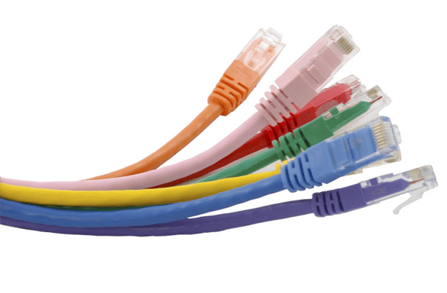
PRESENTED BY PRESENTED TO
NAME: SHEIKH NAFEZ SADNAN MD. AKHTARUZZAMAN ADNAN ID: 20101106 ASSISTANT PROFESSOR SEC: B(2) DEPARTMENT OF CSE DEPT: CSE UNIVERSITY OF ASIA PACIFIC

Slide 3
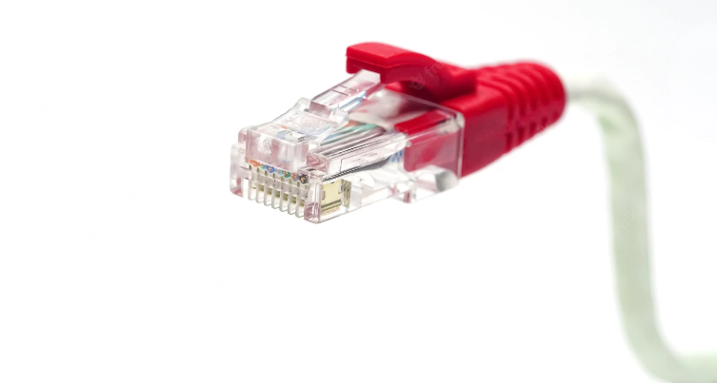
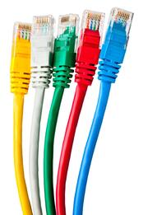
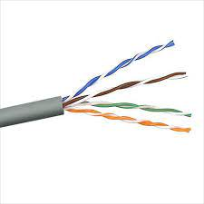
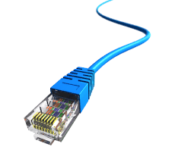
Table of Contents
Definition of Cable
Ethernet Cables
Types of Ethernet Cables
Categories for Ethernet Cables
Usage of Category-Wise Ethernet Cables
Ethernet Cable Color Coding
Ethernet Cable Length
Ethernet Cable Shielding Types
Advantages of Ethernet
Disadvantages of Ethernet
WiFi vs Ethernet

Slide 4
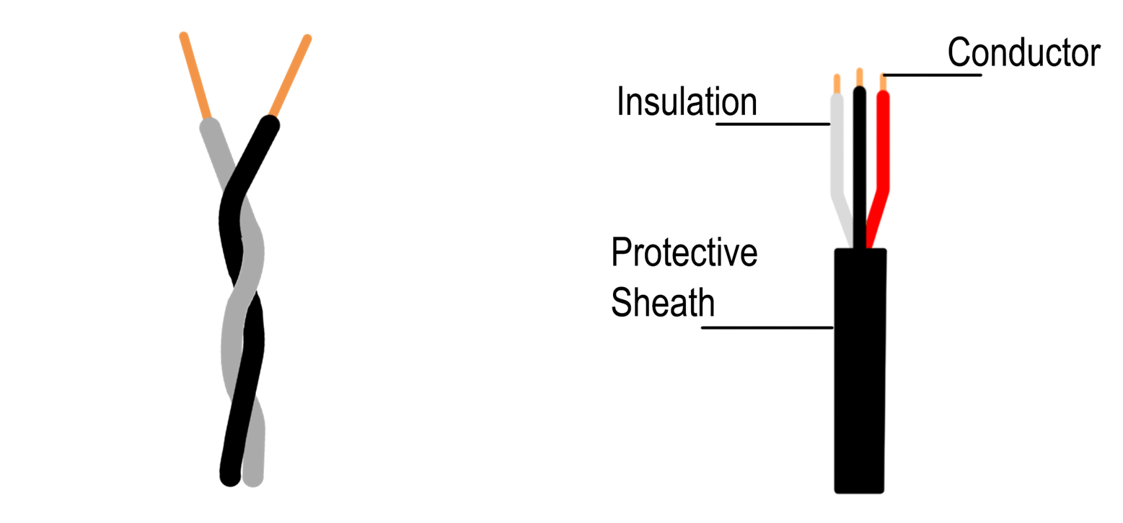
Definition of Cable
Referred as a cord, connector or plug, a cable is one or more wires covered in plastic that transmit power or data between devices or locations.
A cable should have three components:
Conductor
Insulator
Sheath
Fig 01: Cable Components

Slide 5
Ethernet Cables
An ethernet cable carries the broadband signals between your modem, router, computer and other wired internet-capable devices.
Ethernet cables basically allow devices to be connected to the network. It can be a personal computer, tablet, or even a PlayStation. An ethernet cable is like connecting wi-fi to the device by using a wire to connect to the internet.
Ethernet cables are fairly long and has no issues with data loss. They are compatible with almost any kind of hardware as well. Ethernet cables come in different sizes and with different speeds.

Slide 6
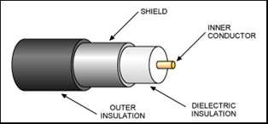
Types of Ethernet Cables
Coaxial Cable: Coaxial cables feature a conductor on the inside which is surrounded by a layer of insulation. This layer is surrounded by another conducting shield. This cable is not affected by outside interference. These cables have a maximum transfer rate of around 10 Mbps. Nowadays, they have been replaced by twisted cabling. Types of Coaxial Cable are 1) RG58 2) RG8 3) RG6 4) RG59
Fig 02: Coaxial Cable

Slide 7
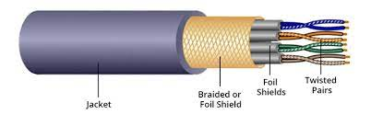
Types of Ethernet Cables (Cont.)
Twisted-pair Cable: This type of cable has 4 pairs of wires. The wires are twisted together to keep outside interference to a minimum. This type of wiring can be found in LANs. There are 2 types of twisted pair cables-UTP and STP. The key difference is the fact that the STP has an extra layer of insulation. Two types of twisted pair cables are 1) Unshielded Twisted Pair 2) Shielded Twisted pair
Fig 03: Twisted-pair Cable

Slide 8
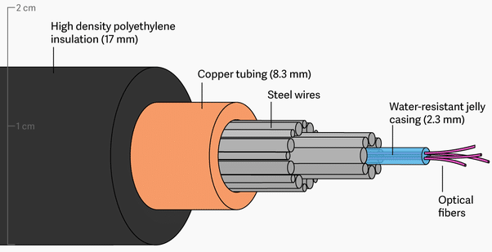
Types of Ethernet Cables (Cont.)
Fiber-optic Cable: These cables make use of optic fibers to transmit data. The data transfer is in the form of light. Within the cable, there are glass strands that are covered by cladding. It is very fast but quite expensive as well. Moreover, the cables are practically immune to electromagnetic interference. Optical fibers are of two types-Single mode fiber and Multi-Mode Fiber. The difference lies in the number of light rays used to transmit data. Two types of fiber-optic cables are: 1)Single-mode fiber (SMF), 2) Multi-mode fiber (MMF)
Fig 04: Fiber-optic Cable

Slide 9
Categories for Ethernet Cables
A variety of different cables are available for Ethernet and other telecommunications and networking applications. These network cables that are described by their different Ethernet cable categories.
Cat-1: This was once used in telephone systems and had two copper wires twisted around each other. It was meant for analog communication. However, it is not recognized by the EIA.
Cat-2: It allows for both voice and data communication. It was mainly used in the IBM token ring networks and had a data transmission rate of 4 Mbps.
Cat-3: Cat 3 came out in the 1990s and had 4 twisted pairs of wires. It is capable of working with networks having frequencies of up to 16 MHz, It was mainly used with 10 Mbps ethernet networks. However, it has been replaced by Cat 5.
Cat-4: Cat 4 had a maximum data transfer rate of 16 Mbps and was used in networks with a frequency of 16 MHz

Slide 10
Categories for Ethernet Cables (Cont.)
Cat-5: Cat 5 arrived in the mid-1990s and has a maximum transfer speed of 100 Mbps. It can transfer data up to a distance of 100 meters. It was the standard ethernet for ethernet cables for a long time. However, currently, it’s obsolete.
Cat-5e: Cat 5 was not recognized by the EIA but the 5e was recognized. It has sped up to 125 Mbps and higher frequency specifications as well. Physically, it is quite similar to the Cat 5.
Cat-6: When compared to the Cat 5, cat 6 offers much higher bandwidth and data transfer rates. It can achieve speeds up to 1 Gbps over a distance of 100m. For shorter distances, the speed can be around 10Gbps. Cat6 has a separator called the Spline to minimize crosstalk and reduce electromagnetic interference. It is also backward compatible with the Cat 5 and 5e.
Cat-6a: Cat 6a is an augmented version of the Cat 6 and can support higher speeds and bandwidth. Crosstalk is absent but the cable is not as flexible as the Cat 6.

Slide 11
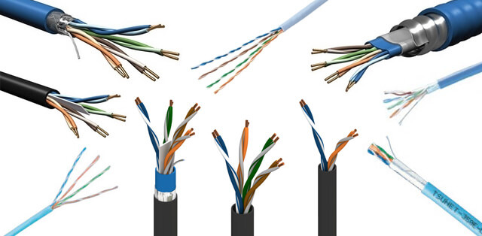
Categories for Ethernet Cables (Cont.)
Cat-7: Cat 7 has similar specifications to the Cat 6a and has a robust shielding and allows for a maximum data transfer rate of around 10 Gbps and a bandwidth of 600 MHz.
Cat-7a: Cat 7a had a maximum speed of 10 Gbps and was used in networks with a frequency of 1000 GBps.
Cat-8: Cat 8 cables are more expensive than Ca7 or the Cat 6a but are much more capable. They support a data speed of 40 Gbps and come with a maximum bandwidth of 2000 MHz.
Fig 05: Different category of cables

Slide 12
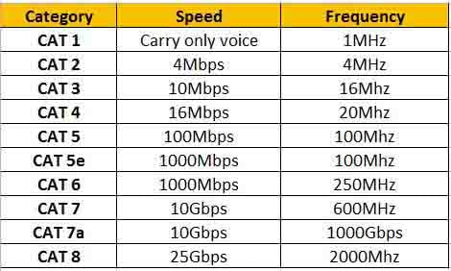
Categories for Ethernet Cables (Cont.)
Fig 06: Category-wise Speed and Frequency

Slide 13
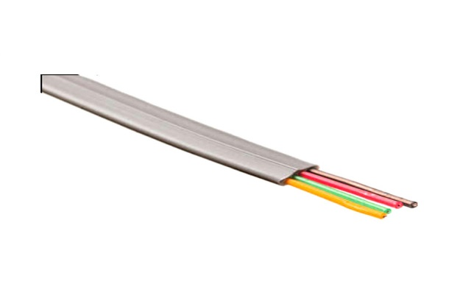
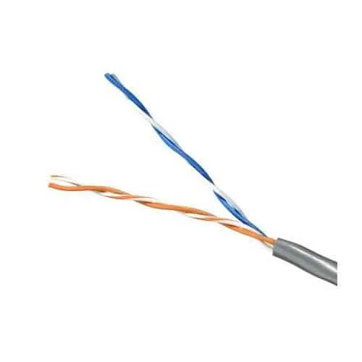
Usage of Category-Wise Ethernet Cables
Category 1: Telephone and modem lines Fig 07: Cat-1 cable Category 2: LocalTalk & Telephone Fig 08: Cat-2 cable

Slide 14
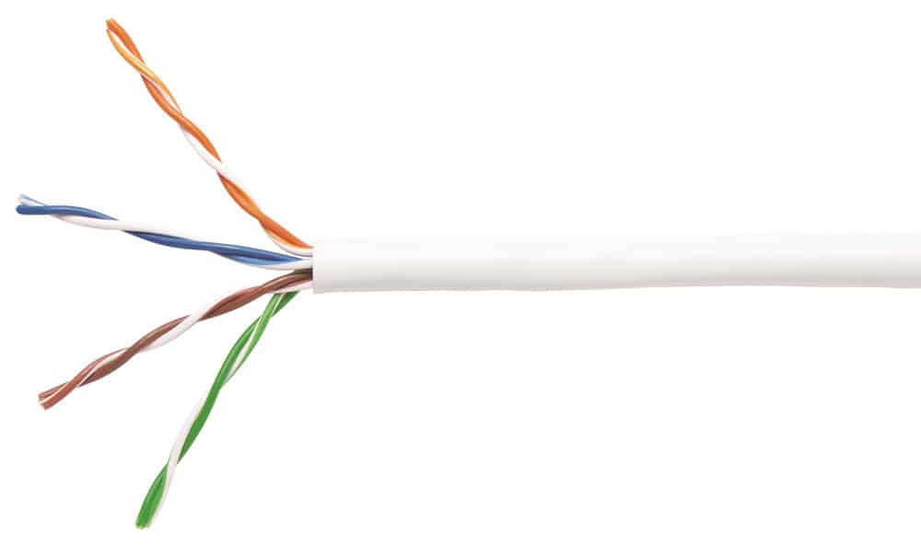
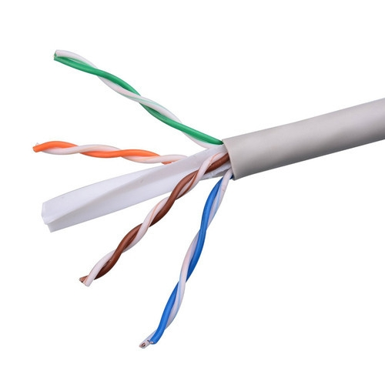
Usage of Category-Wise Ethernet Cables (Cont.)
Category 3: 10BaseT Ethernet Fig 09: Cat-3 cable Category 4: Token Ring Fig 10: Cat-4 cable

Slide 15
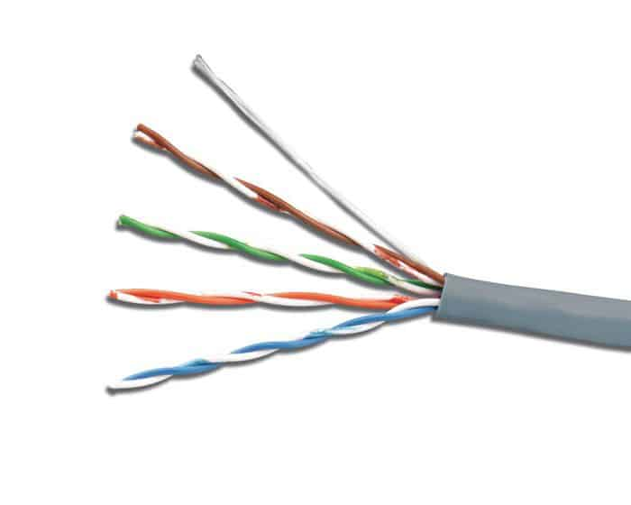
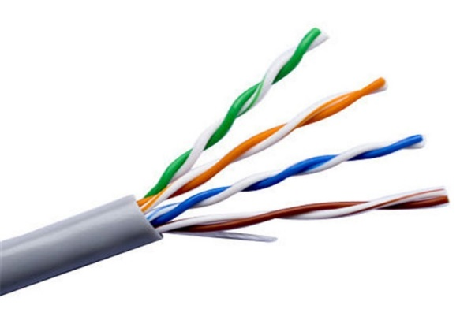
Usage of Category-Wise Ethernet Cables (Cont.)
Category 5: 100BaseT Ethernet Fig 11: Cat-5 cable Category 5e: 100BaseT Ethernet, residential homes Fig 12: Cat-5e cable

Slide 16
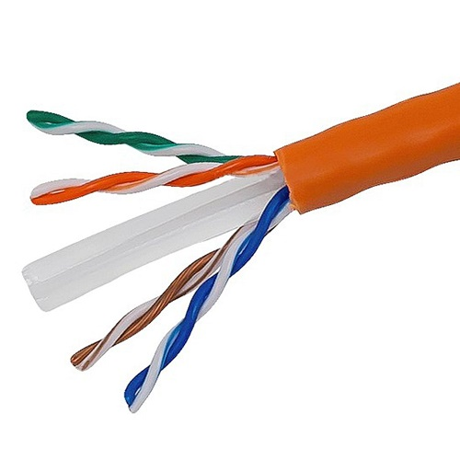
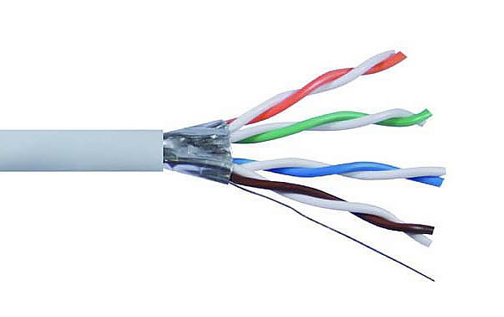
Usage of Category-Wise Ethernet Cables (Cont.)
Category 6: Gigabit Ethernet, commercial buildings Fig 13: Cat-6 cable Category 6a: Gigabit Ethernet in data centers and commercial buildings \ Fig 14: Cat-6a cable

Slide 17
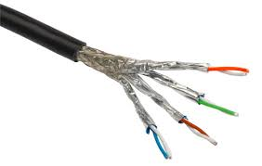
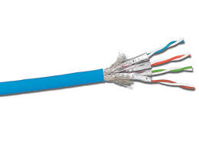
Usage of Category-Wise Ethernet Cables (Cont.)
Category 7: 10 Gbps Core Infrastructure Fig 15: Cat-7 cable Category 7a: 10 Gbps Core Infrastructure Fig 16: Cat-7a cable

Slide 18
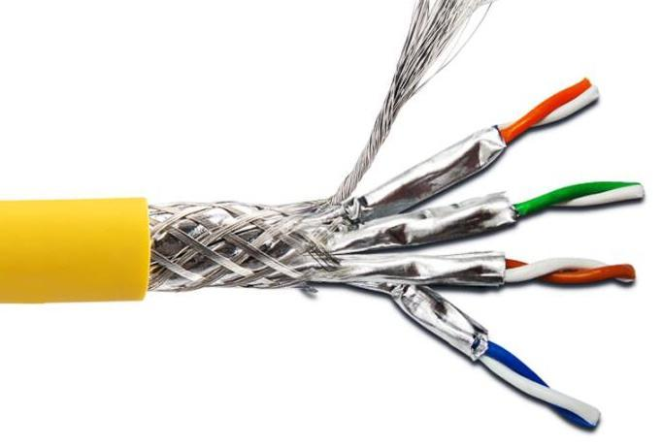
Usage of Category-Wise Ethernet Cables (Cont.)
Category 8: 25 Gbps/40 Gbps Core Infrastructure Fig 17: Cat-8 cable

Slide 19
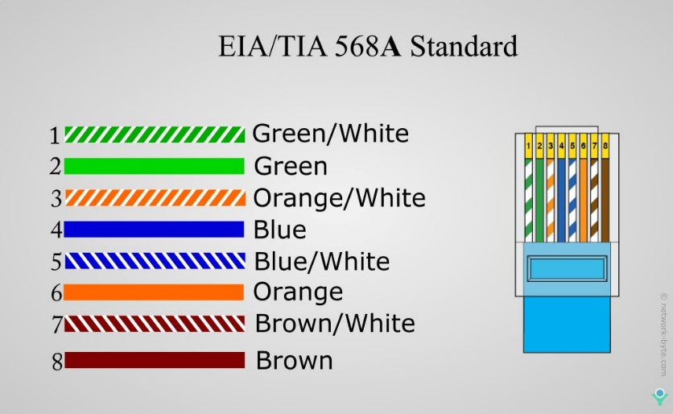
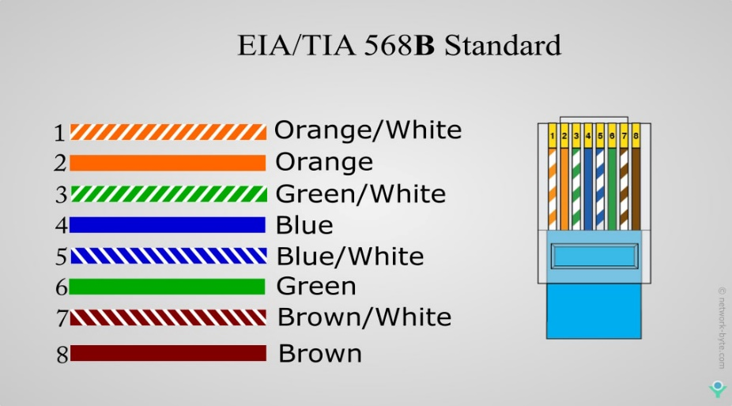
Ethernet Cable Color Coding
Ethernet cable which is used to connect networking devices through UTP cable and end is terminated with RJ45 connector. In UTP cable consist of 4pair or 8 wire of different color that is used to terminate on RJ45 or 8P8C connector. Ethernet cable color coding as standardized by EIA(Electronic Industries association) and TIA(Telecommunication Industry Association) there are two standard EIA/TIA-568-A and EIA/TIA-568-B. Fig 18: Color coding

Slide 20
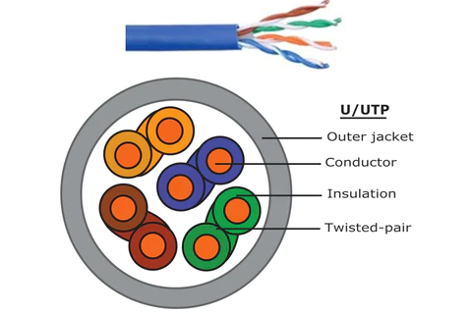
Ethernet Cable Shielding Types
U/UTP - Unshielded Cable / Unshielded Twisted Pair: This Ethernet cable is completely unshielded. It can be used in situations that lack nearby electromagnetic interference (EMI), and that are not affected by electrostatic discharge (ESD). The lack of shielding allows for the construction of cable that is thinner and more flexible than shielded cable, and so it’s usually easier to install. Unlike shielded Ethernet cable, it does not require a ground connection. A plastic spline is often found in the center of both shielded and unshielded Ethernet cable, to offer protection against crosstalk from both internal pairs and external cables. Fig 19: U/UTP

Slide 21
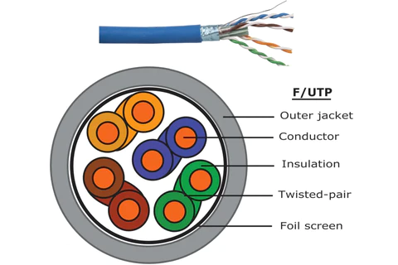
Ethernet Cable Shielding Types (Cont.)
F/UTP - Foil Shielded Cable / Unshielded Twisted Pair: This Ethernet cable has an aluminum foil shield (screen) around the entire cable, beneath the jacket. It can help protect data from nearby sources of electromagnetic interference (EMI), and can help dissipate any buildup of electrostatic potential. A small drain wire, shown in the photograph but not in the diagram, redirects unwanted noise to ground. This drain wire must be properly grounded, otherwise any benefit from shielding will be lost and the ungrounded screen will actually attract unwanted noise. Fig 20: F/UTP

Slide 22
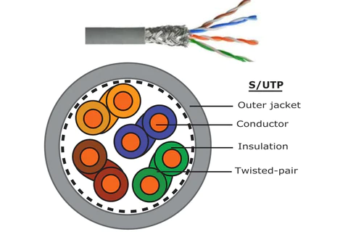
Ethernet Cable Shielding Types (Cont.)
S/UTP - Screen Shielded Cable / Unshielded Twisted Pair: Instead of a foil shield, this Ethernet cable uses an aluminum braided shield (screen) around the entire cable, beneath the jacket. Like a foil shield, it can help protect data from nearby sources of electromagnetic interference (EMI), including crosstalk from nearby cables and can help dissipate any buildup of electrostatic potential. The braided construction of the shield offers better protection from radio frequency interference (RFI). Also, the braided shield provides greater mechanical strength and better grounding than a foil shield. Fig 21: S/UTP

Slide 23
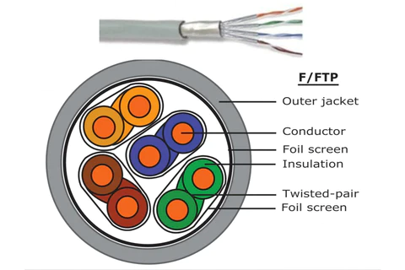
Ethernet Cable Shielding Types (Cont.)
F/FTP - Foil Shielded Cable / Foil Shielded Twisted Pair: Like the F/UTP Ethernet cable, this cable has an aluminum foil shield (screen) around the entire cable, beneath the jacket. In addition, each individual twisted pair is also wrapped in a foil shield. This construction is designed to minimize crosstalk between pairs in the same cable. Also, the shielded pairs, along with the overall shield provide more protection against external electromagnetic interference than the jacket shield alone. Fig 22: F/FTP

Slide 24
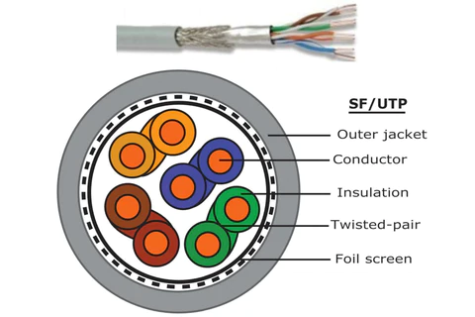
Ethernet Cable Shielding Types (Cont.)
SF/UTP - Foil and Braid Shielded Cable / Unshielded Twisted Pair: This Ethernet cable is similar to F/UTP cable and S/UTP cable except that it has both a foil shield and a braided shield. The individual twisted pairs are unshielded. The braided shield offers better protection from RFI, better grounding, and greater mechanical strength than the foil shield alone. With both shields present, a greater range of interference frequencies can be blocked or absorbed. Fig 23:SF/UTP

Slide 25
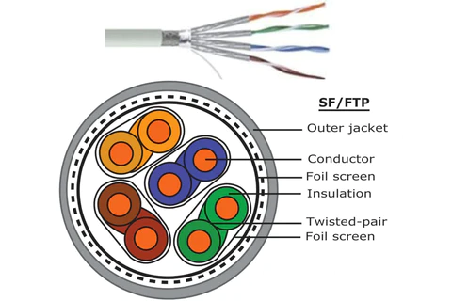
Ethernet Cable Shielding Types (Cont.)
SF/FTP - Foil and Braid Shielded Cable / Foil Shielded Twisted Pair: This Ethernet cable is designed to provide the maximum protection from internal crosstalk, alien (external) crosstalk, EMI, ESD, and RFI. It has all the benefits of SF/UTP cable, with the added protection of individually shielded twisted pairs. The drain wire can be clearly seen in the photograph. As might be expected, the three layers of shielding will tend to make this cable thicker and less flexible than other cables of the same category. This can make installation more challenging and labor-intensive. Fig 24:SF/FTP

Slide 26
Advantages of Ethernet
Speed: Speed offered by Ethernet is much greater than compared to the wireless connection. This is because Ethernet provides one to one connection. As a result, a speed of 10Gbps or sometimes 100Gbps can be easily achieved. Efficiency: Ethernet cable like Cat6 consumes a lower amount of power which is even lower than a wifi connection. So these types of ethernet cables are considered to be the most power-efficient. Good data transfer quality: As it is strong to noise so the quality of the information transferred doesn't degrade. Security: The Ethernet connection provides a higher level of security when compared to a wireless connection. Ethernet connection generally provides control over who is using the network and hence any sort of information won't be easily available for the hackers. Relatively low cost: To form an ethernet we do not need much cost. It is really inexpensive. Reliability: Ethernet connections are one of the most reliable connections because of their no or zero interruptions from the radio frequencies. As a result, there is less disconnection, less slowdown, and no shortage of bandwidth.

Slide 27
Disadvantages of Ethernet
Expandability: It is generally intended for shorter and smaller distances. In case if you want to expand the network then there will be additional expenses and it will be time-consuming in the ethernet. This is because there will be an additional need for routers, switches and all the devices need to be rewired. Connections: The number of connections is restricted in Ethernet. If you are using a single ethernet connection then only a single device can be connected. If you want to connect multiple devices then you need to use more cables. Mobility: Mobility is limited. Ethernet is ideal to use in places where the device needs to sit in particular places. Installation: Ethernet connection is harder to install without any professional's assistance.

Slide 28
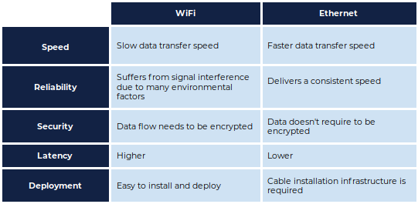


WiFi vs Ethernet

Slide 29


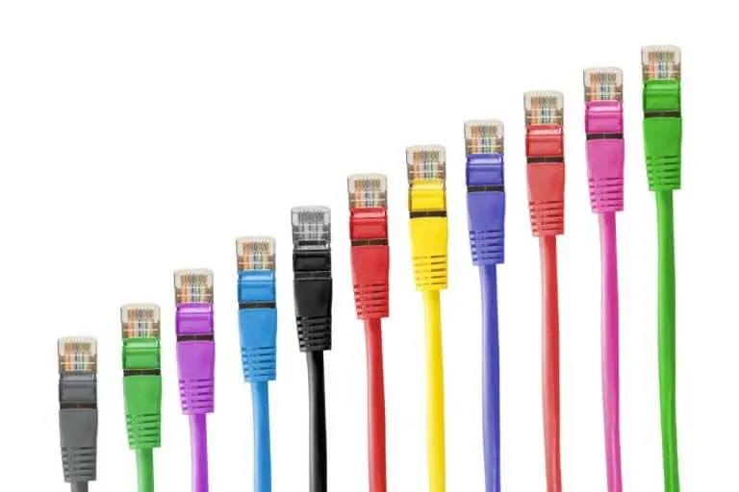
THANKS!
Any questions?
20101106@uap-bd.edu

